Slide 1
15th SPIAC-B meeting
19th March 2024

Slide 2
SPIAC-B Working Group on Linking Humanitarian Assistance and Social Protection
Updates – 19 March 2024
Charlotte Bilo

Slide 3
Overview
Background: from 2019 until 2021 the group was known as the Grand Bargain Cash Workstream Subgroup on Linking Humanitarian Cash with Social Protection; in 2021 the group became a SPIAC-B working group
Objective: To contribute to strengthening the links between humanitarian assistance and social protection, with cash transfers as the entry point
Why linking HA and SP?
  More people live in contexts of protracted crises, requiring new ways of working together and stronger coherence between interventions across the HDP nexus.
  Linking HA and SP provides a clear entry point for development and humanitarian actors, and government and non-governmental actors, to work together towards our collective goal of better assistance for vulnerable populations.
Co-leads: UNICEF, FCDO and IFRC
30+ members from UN agencies, donors, INGOs and the Int. Red Cross and Red Crescent Movement, including both humanitarian and social protection stakeholders
4 areas of work:
Knowledge Sharing & Generation
Advocacy
Coordination
Capacity Building

Slide 4
Updates
Achievements from 2023 and next steps

Slide 5
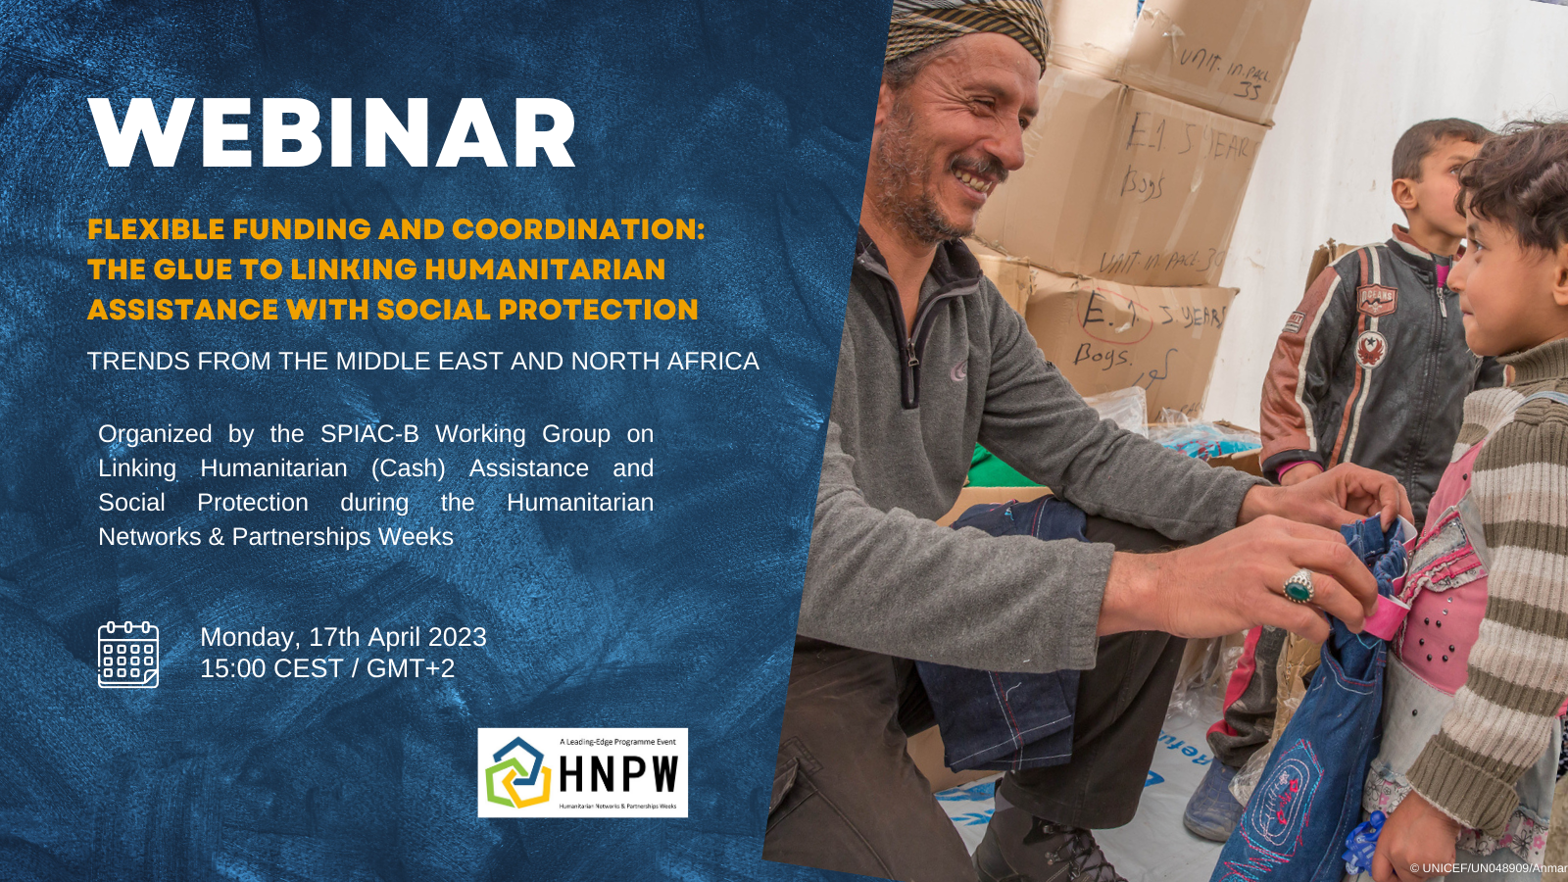
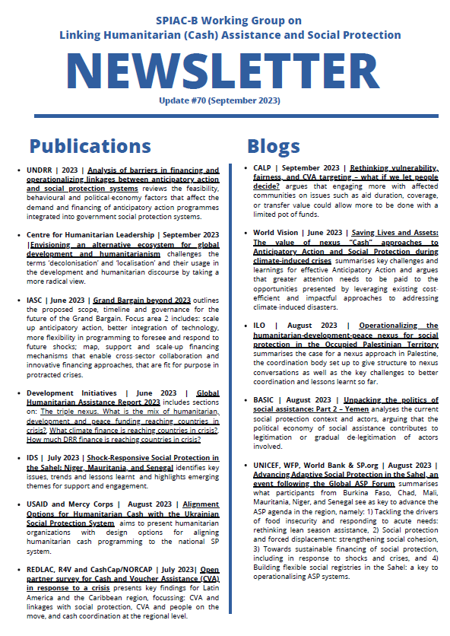
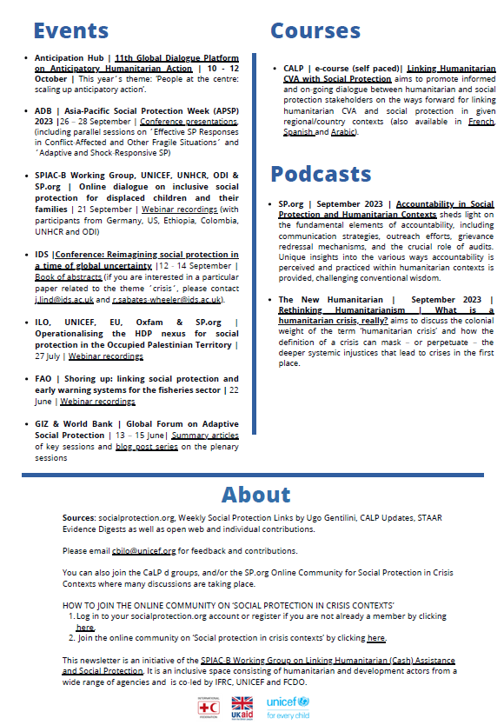
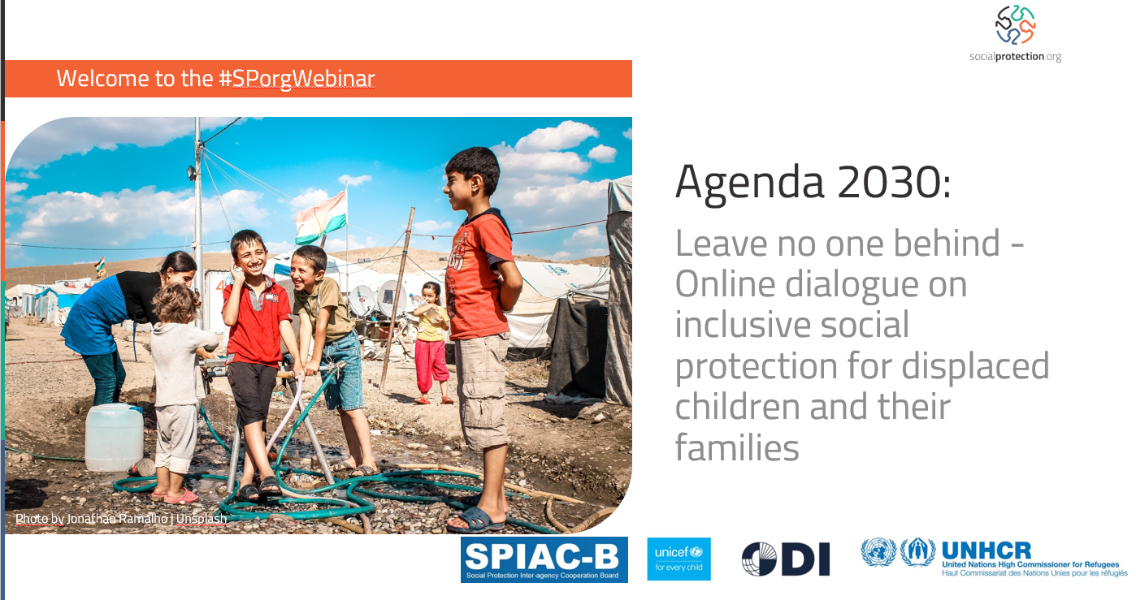
Webinars and Newsletters
See here for links to webinar recordings and past editions of the Newsletter
Notes:
The working group organised 2 webinars in 2023:
Flexible funding and Coordination: The glue to linking humanitarian assistance with social protection - Trends from the Middle East and North Africa (17 April 2023 - during the HNPW): https://vosocc.unocha.org/Report.aspx?page=o0t9pExuBwNxxxslashG2bceJxfTT2uVJnZbo80IXRqQInKLowxxxequal
Agenda 2030: Leave no one behind - Online dialogue on inclusive social protection for displaced children and their families (21 September 2023): https://socialprotection.org/learn/webinars/agenda-2030-leave-no-one-behind-online-dialogue-inclusive-social-protection-displaced
5 bi-monthly newsletter with latest publications, events, blog posts and courses related to the topic of linking Humanitarian Assistance and Social Protection.
Recordings of the webinars and past editions of the newsletter can be found here: https://socialprotection.org/connect/communities/social-protection-crisis-contexts/spiac-b-working-group-linking-humanitarian
Please reach out to Charlotte Bilo (cbilo@unicef.org) if you would like to receive the Newsletter.

Slide 6
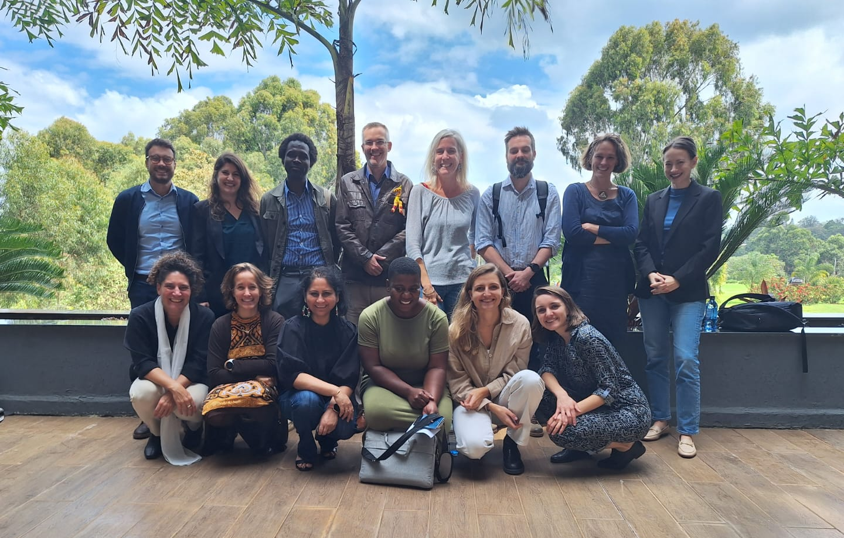
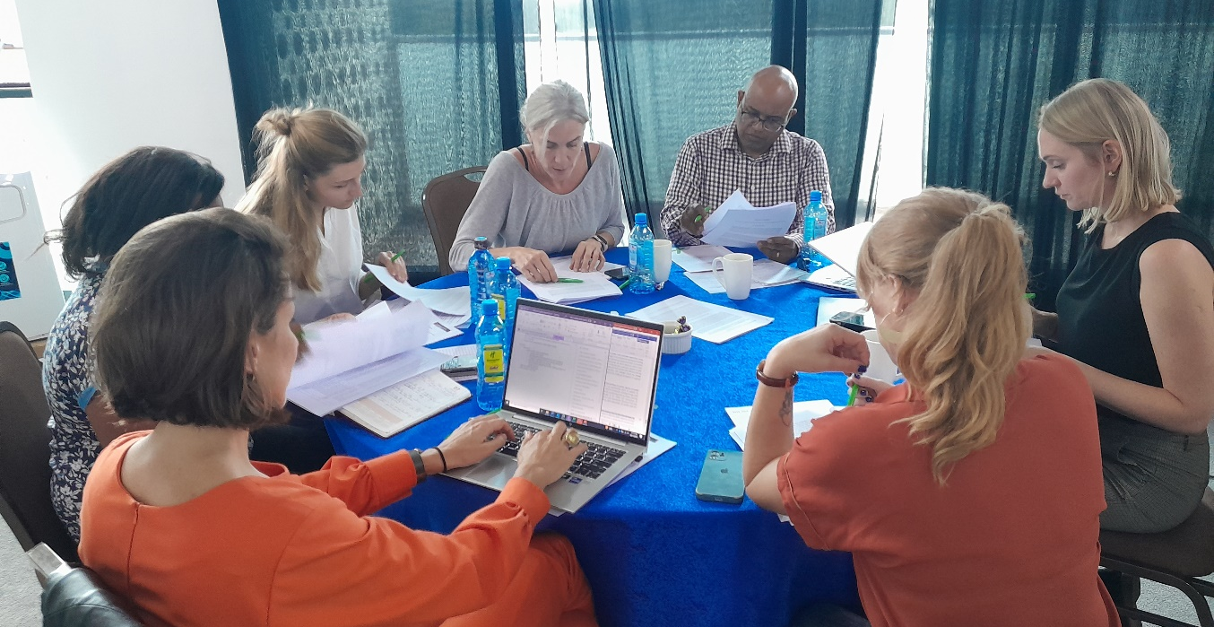
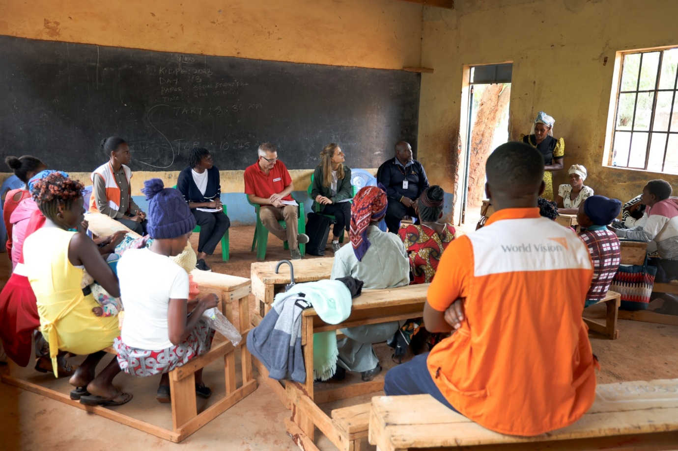
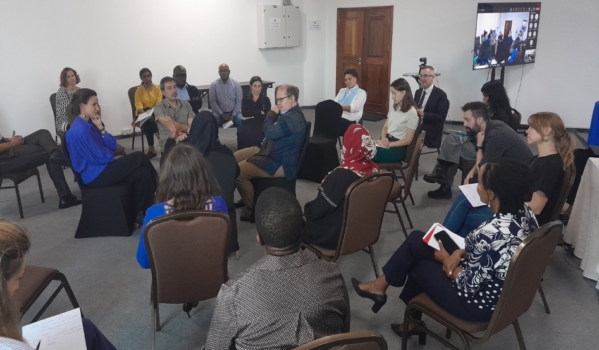
Annual Workshop in Nairobi – Nov 6th - 9th 2023
See here for a blog post summarising the workshop
Notes:
Every year the group organises an annual workshop, to provide a platform for exchange and hold deeper conversations on certain topics. Last year, the group met in Nairobi. From Nov 6th to 9th a mix of panels with external speakers, group activities as well as a field trip were organised with 2 main objectives:
To finalize the ´Common Principles´ document to guide work and advocacy of the working group and agree on next steps
To discuss how people’s needs can be better met through HA-SP linkages in contexts of climate induced shocks, conflict and displacement (focus on Kenya and Somalia)
A blog post with a summary is available here: https://socialprotection.org/discover/blog/annual-workshop-spiac-b-working-group-linking-humanitarian-cash-assistance-and-social

Slide 7
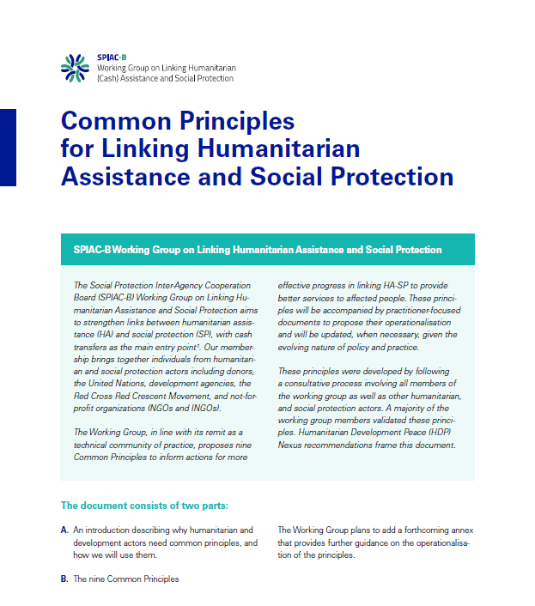
Common Principles
What?
Nine Common Principles to inform actions for more effective progress in linking Humanitarian Assistance and Social Protection
Highlights principles which can be considered universal, as well as those which apply to specific crisis contexts (such as climate shocks, displacement and conflict)
Developed through a consultative process
Whom for?
Working Group itself
Humanitarian and Development Actors
What´s next?
Dissemination + Webinars
Taskforces are developing practitioner-focused briefs on HOW TO implement the Principles (forthcoming)
Notes:
https://socialprotection.org/discover/publications/common-principles-linking-humanitarian-assistance-and-social-protection

Slide 8
Thank you!
Please reach out to Charlotte Bilo (cbilo@unicef.org) for any questions or suggestions.
Visit also our page in the Online Community Social protection in crisis contexts on socialprotection.org for more information.

Slide 9

15th SPIAC-B Meeting, March 2024
Advancing social justice, promoting decent work

Slide 10
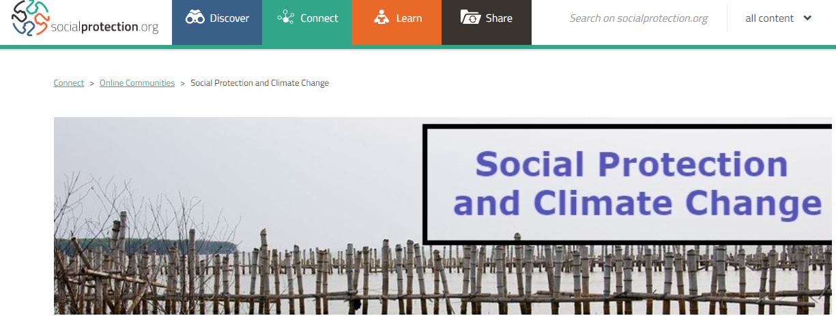
Recap: About the working group
Objectives of the working group:
Exchange and sharing information, research/ongoing work and experience
Advocacy on the role of social protection for climate change
Developing bridges and synergies between social protection and climate change communities
Co-chairs:
ILO, Red Cross Red Crescent Climate Centre, FAO
Advisory Group:
AFD, FCDO, GIZ, IDOS, WFP, World Bank, CCASP, UNDP
How we work:
Over 200 members from academia, international organisations, NGOs and humanitarian organisations, and governments
Quarterly full working group meetings and ad-hoc technical meetings
Community page on socialprotection.org
Linked to both SPIAC-B and USP2030
Notes:
Sayanti

Slide 11

Highlights of 2023
Started engagement with UNFCCC – specifically on Just Transition
Joint statement – «Directing international climate finance to social protection» available here.
Collaboration with finance working group on technical paper – social protection and climate finance
Ad-hoc technical meeting on adaptation: integration of SP in NDCs/NAPs; role of graduation for climate resilience
Joint side-events at COP28
  Loss and Damage: reaching children and other vulnerable groups with inclusive and adaptive social protection as a crucial response to the climate crisis (World Bank, UNICEF, BMZ/GIZ, RCCC)
  Building social protection systems to support a just transition (ILO, supported by FAO, USAID, BMZ/GIZ, BRAC) – recording here
Notes:
Sayanti

Slide 12

Plans for 2024 and beyond
Continue focus on exchange and sharing information, research/ongoing work and experience
Ad-hoc technical meetings on demand
  1. Meeting of 2024: social protection and climate finance (April 2024)
Re-newed focus on linkages to UNFCCC processes, including on Just Transition, Adaptation and Loss and Damage
Collaboration on COP29
Strategy to extend collaboration of WG with national governments
Notes:
Sayanti

Slide 13
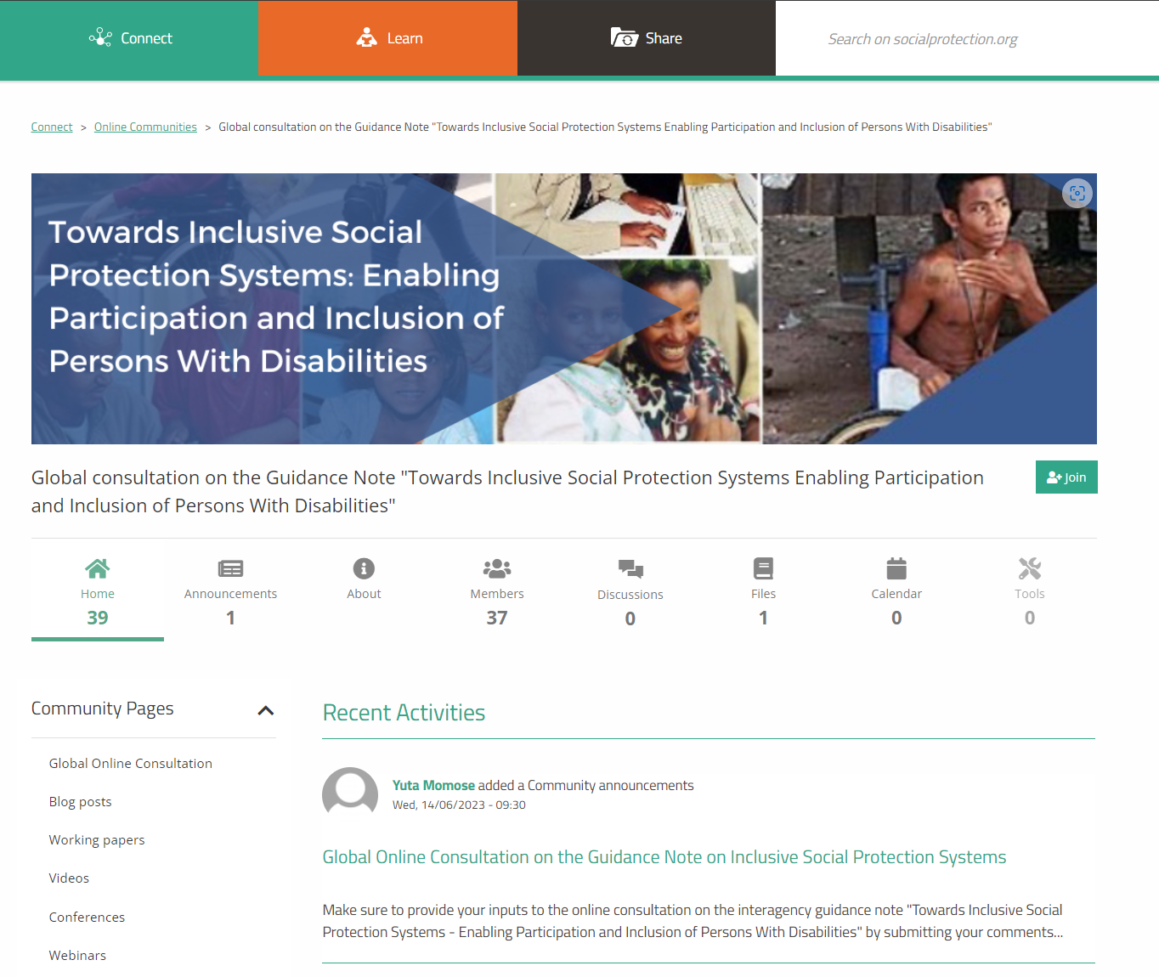
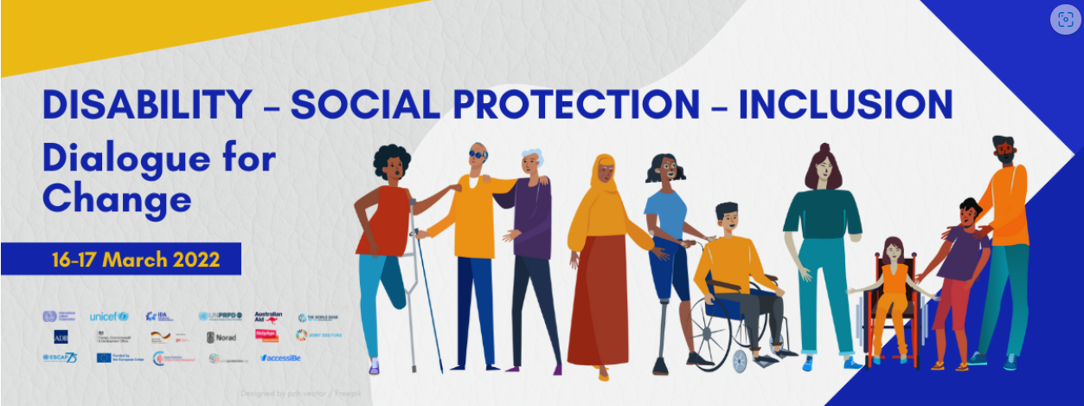
Disability working group
  Finalisation of the guidance note
  Public consultation
  Revision in line with feedback received
  Formatting and publishing
  Dissemination: webinar series with SP.org
  Launch: COSP in June 2024
  ISPA tool 2025

Slide 14
Digital Social Protection
Update of the
SPIAC-B Working Group on Digital Social Protection
March 2024

Slide 15
Objectives
Encourage cooperation on
  explorative studies, concepts, disruptive technologies,
  capacity building,
  digital public goods and
  events to enhance dialog and convergence in digital social protection across organizations and agencies.
Various workstreams according to the objectives
  Various leads from among the members

Slide 16
Current Discussion and Main Topics
Concepts, guidelines, studies, DPGs and events
19 March 2024

Slide 17
Key Workstreams – work in progress
AI for Social Protection:
  3-day workshop in November with various country cases and thematic inputs
Data workstreams:
  Open data approach
  Data analysis and dashboard for SP
  Exchange of data/ data sharing with link to interoperability and portability of benefits
  Data governance framework
  Data protection guideline “Good Practices for Ensuring Data Protection and Privacy in Social Protection Systems”
    Updated version 1.1 with focus on AI, big data, cloud technology and technology providers (End March 2024)

Slide 18
Key Workstreams – work in progress
ISPA tool:
  Looking currently for pilot countries
Opportunities and Risks on interoperability/digital tools for SP
  discussion paper developed
  Workshop in April
Interoperability / DCI (www.spdci.org)
  First standard published (CRVS & SP MIS)
  SR and IBR with SP MIS – Review phase ongoing

Slide 19
What have we achieved?
A few examples of published concepts, guidelines & studies
19 March 2024

Slide 20
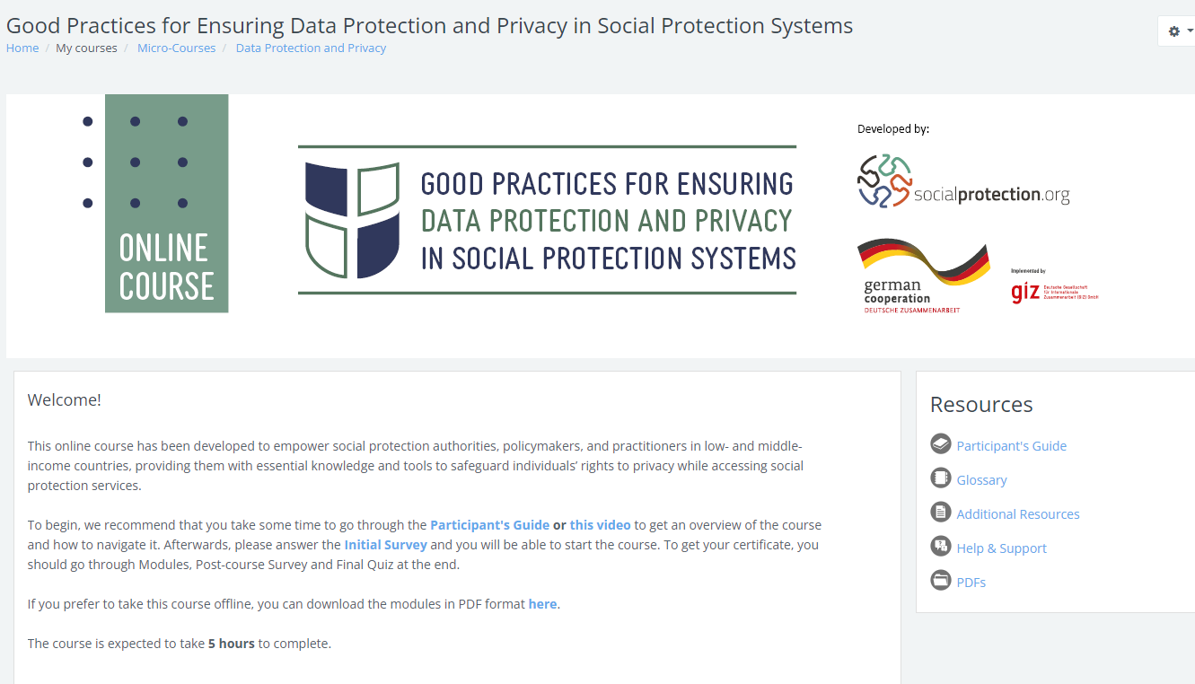
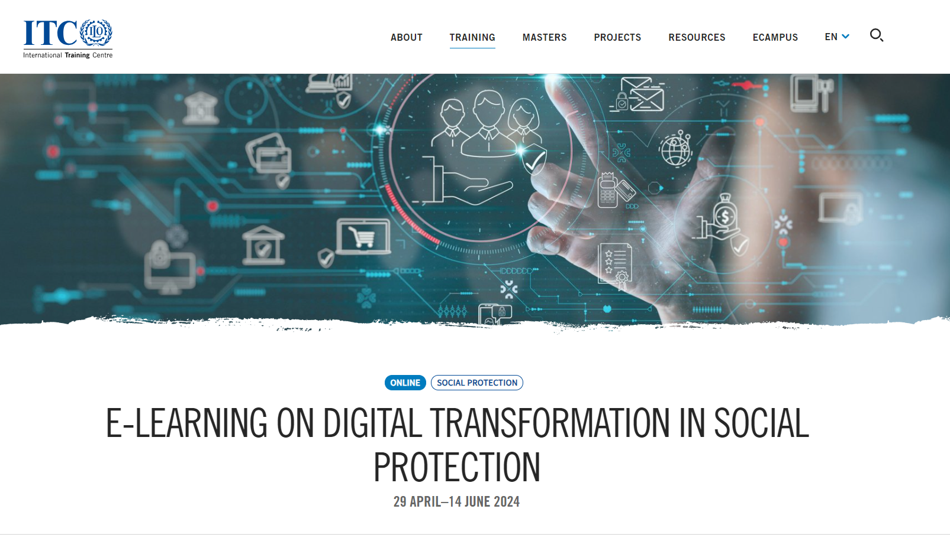

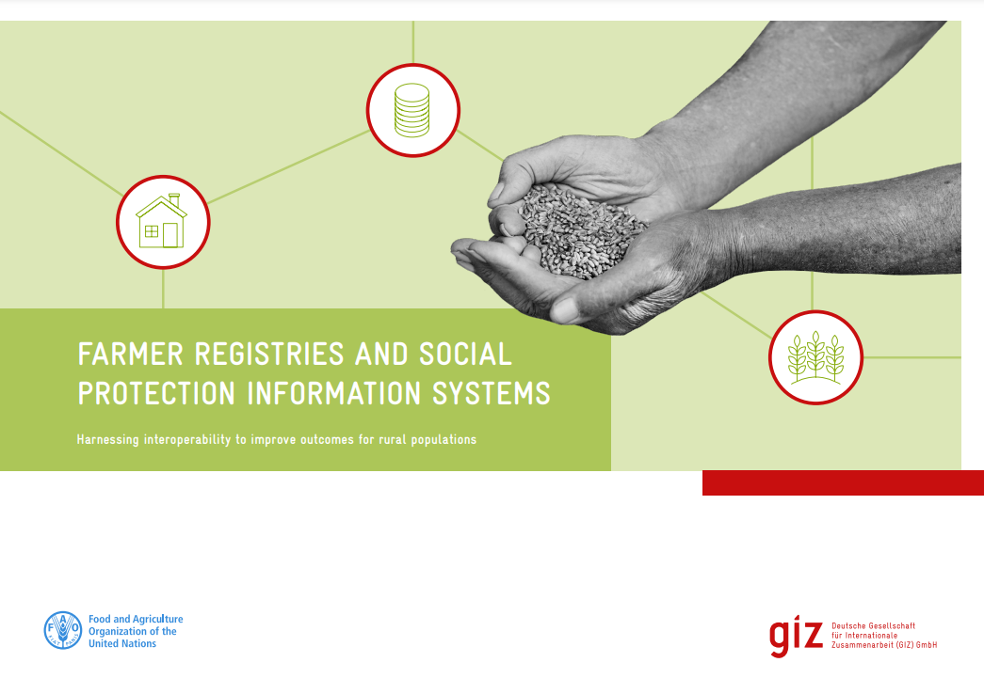
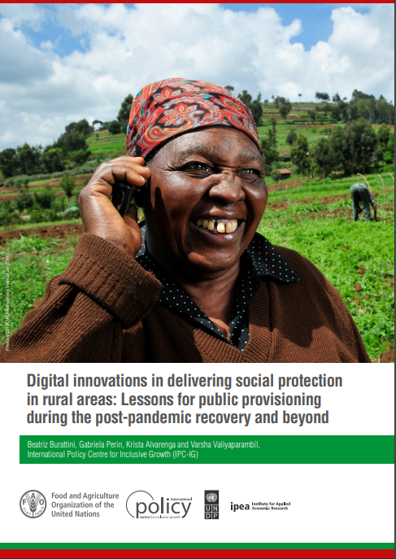
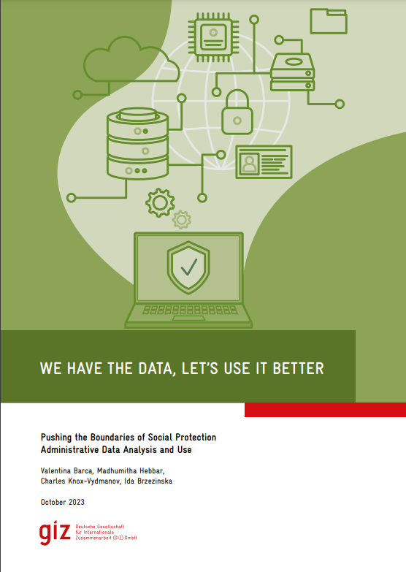
What have we achieved?
A few examples of published concepts, guidelines; studies & e-learning courses
Data protection e-learning course available on socialprotection.org: “Good Practices for Ensuring Data Protection and Privacy in Social Protection Systems”
  Online since February 2024 Access here
E-Learning on Digital Transformation in Social Protection | ITCILO
  The next edition will take place: 29 April – 14 June 2024 Register here
Novel digital data sources for social protection: opportunities and challenges
  Published August 2023 Download here
Farmer Registries and Social Protection Information Systems: Harnessing Interoperability to Improve Outcomes for Rural Populations
  Published February 2023 Download here
Digital innovations in delivering social protection in rural areas: Lessons for public provisioning during the post-pandemic recovery and beyond
  Published January 2023 Download here
We Have the Data, Let’s Use It Better: Pushing the Boundaries of Social Protection Administrative Data Analysis and Use
  Published October 2023 Download here
19 March 2024

Slide 21
Thank You

Slide 22
G20 INITIATIVE FOR A GLOBAL ALLIANCE AGAINST HUNGER AND POVERTY

Slide 23
Objectives
Create a Global Alliance to support the national implementation of a trusted set of policies that
  build resilience against climate, public health and economic shocks,
  promote access to adequate and nutritious food for healthy diets, and
  uplift the poor in vulnerable situations, providing sufficient income to allow for human dignity and development, while
  seeking to address inequalities and to promote just transitions
Outputs of the TF to prepare for the launch of the Global Alliance:
  Declaration on the Fight Against Hunger and Poverty
  Define a foundational set of policies and programs to be covered by the Global Alliance
  Define founding instruments (Governance structure and Terms of Accession)

Slide 24
G20 Report – Outline/Key messages
SPIAC-B
State of hunger and poverty
  Diversity/intersectionality and multidimensionality of poverty
  Conflict and environmental degradation as key acute drivers but also underlying structural factors causing chronic poverty
Evidence regarding the impact of social protection and economic inclusion programmes on hunger and poverty but large coverage gaps
  Positive impacts on various dimensions of poverty
  Also strong impacts on FSN but not automatically
  Gaps regarding population coverage, adequacy, comprehensiveness and financing
What works/ pathways for extension
  Integrated approaches
  Legal entitlements
  Progressive extension, using a variety of mechanisms
  Strengthening implementation mechanisms
  Mobilizing domestic resources
  Building on existing structures (South-South learning, GA, Sp.org)
Final report due on 24 July Ministerial-Level meeting
Notes:
Structural factors: inequalities, pervasive discrimination, low productivity, unfavourable macroeconomic policies and trade regimes, as well as the weakness of public institutions, have contributed to poverty, hunger and malnutrition
Coverage gaps vary by region, income level and life cycle risks

Slide 25

Country implementation
Integrated approaches to combine social protection with access to other goods and services relevant for food security or nutrition: skills development, health and care services, access to finance or agricultural inputs
Strong implementation mechanisms build on a combination of digital solutions and in-person support along the delivery chain.
Institutionalized social protection systems and benefits anchored in national legislation while removing legal and administrative barriers
Progressive building of coherent social protection systems, combining social insurance and tax-financed social protection benefits, and complemented by public services and based on national and social dialogue
Photo by Benjamin Wong on Unsplash
=> We can build on a wealth of experiences and delivery mechanisms built over the past decades in many countries
Notes:
Legal entitlements ensure/generate
Predictability/certainty
Enforceability (complaint and appeal mechanisms)
Sustainability
Automatic shock-responsiveness
Trust in public institutions
Food and nutrition-security sensitive social protection requires:
Targeting / eligibility criteria that take into account food insecure or populations at risk of malnutritrion: pregnant and breastfeeding women and girls and children in their first 1000 days, or under age 5 when possible
Benefit levels that are set in line with costs of a health diet
Benefits modalities (duration, frequency) designed in line with seasonal needs and nutrition objectives (e.g. for the full duration of the first 1,000 days of life)
The combination of social protection benefits with awareness/education/behavioral change communication
Strong coordination between nutrition, health and other social protection intervention
Shifting public food procurement towards healthier options
Encouraging productive employment along the food value chain
Removing legal, financial, administrative and information barriers
Legal reforms:
Social Security Law in Jordan extends mandatory social insurance coverage to all workers, including self-employed workers,
Brazil introduced a category of micro-entrepreneurs, subsidized rural pension scheme calculates contributions as a percentage of the sales value of their produce,
Algeria: mandatory National Social Security Fund for Non-Wage Earners
Administration:
Mobile offices: Brazil and South Africa,
One-Stop-shops or Single-Window-Offices e.g. in Mongolia,
Collective insurance agreements facilitated by rural producers’ associations ensure that farmers can be covered by social insurance on the same terms as workers employed in other sectors, Costa Rica
Contribution collection in line with seasonal patterns, Mongolia, Brazil, Colombia
Digital technologies for registration, notification, payments, complaints and appeals

Slide 26
Sustainable, equitable and sufficient Financing
Assign
greater priority to social spending within government budgets.
Enhance
the progressiveness and effectiveness of the tax system to increase tax revenue and ensure equity in financing efforts.
Increase
revenues from social insurance contributions by expanding coverage of social insurance schemes to previously uncovered workers.
Improve
the efficiency and transparency of public financing of social protection across all relevant levels and agencies of government and partners.
Ensure
adequate provision of shock-responsive financing.
Leverage
climate financing for Social Protection to ensure a just transition
Engage in
inclusive national and social dialogue to determine the reforms and financing of the social protection system.
Source: USP2030 Joint Statement: Principles for Financing Universal Social Protection

Slide 27
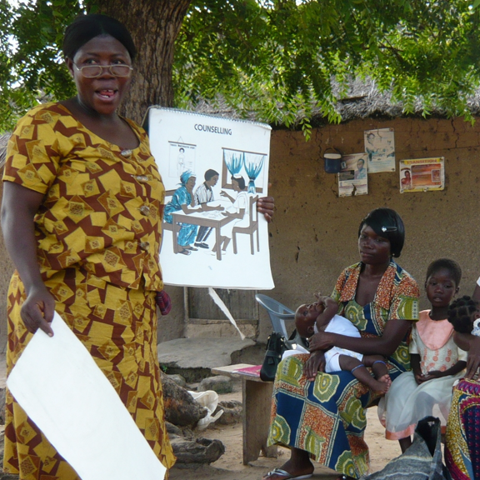
Knowledge sharing and strengthening capacities
Institutionalized structures for sharing knolwedge and experiences – SP.org, South-South and triangular learning
Multilateral/Multisectoral coordination for sharing knowledge through technical support – Global Accelerator
Broad range of training offers across the UN system, agencies and World Bank (UNSSC, ILOITC, WB flagship courses), including from the global south (TRANSFORM)
Photo: ILO

Slide 28
Key points from the first TF meeting
Strong endorsement of the focus on SDG 1 and 2
Overall, interventions spoke more to the «Hunger» element (Food Security and Nutrition / Agrifood Systems) than to the «Poverty» element (Social Protection and Economic Inclusion)
Importance of Social Protection strongly acknowledged, including opportunity for improving nutrition outcomes
Social Protection contributions often focussed on benefits for the poor and building resilience
Delegates requested more attention to inequality and gender in the alliance
On the process: lack of clarity regarding the Alliance pillar 2 and 3 on knowledge and financing and regarding the overall governance of the Alliance

Slide 29
Next steps
Next meetings:
  20-22 March: 2nd meeting (in person) => key messages from SPIAC-B?
  19-21 April: Side event at the IMF-World Bank Spring Meetings (Finance track)
  22-24 May: meeting (in person) with development working group
  June: optional virtual meeting if needed
  24 July: Ministerial-Level Meeting (adoption of the declaration)
Finalization of the SPIAC-B report for July meeting

Slide 30
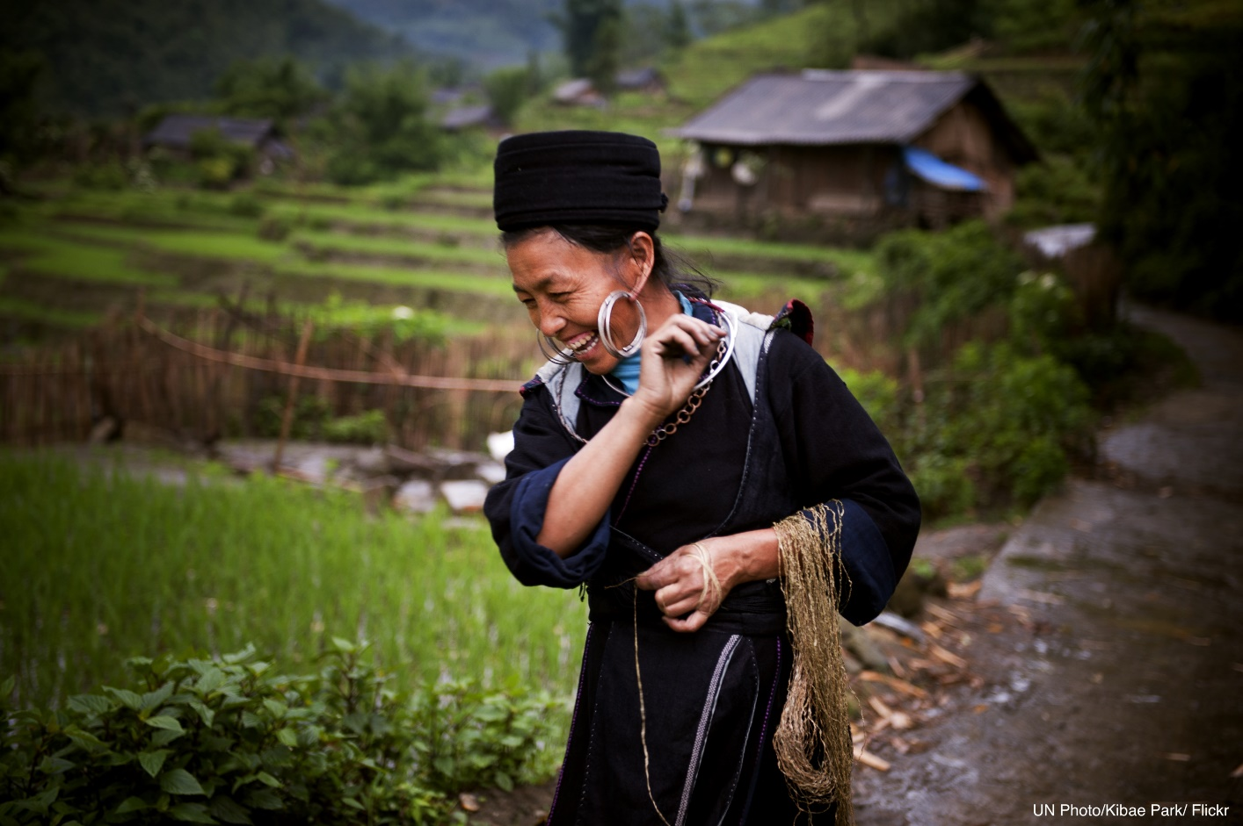
socialprotection.org
SPIAC-B Meeting
19 March 2024
Notes:
Thank you for allowing me the opportunity to provide updates on the institutional and financial status of the socialprotection.org platform.

Slide 31


Timeline
August 23 – Call of Expression of Interest for a new host with:
Full respect for agency neutrality
Mandate to operate globally
Ability to enter into agreements with UN and donor agencies
Proven expertise in knowledge management and Social Protection
Proven effectiveness in project management
The platform becomes a global reference of knowledge sharing and capacity building for the social protection sector
Temporary SPIAC-B working group on the socialprotection.org platform was set
2015
2022
2023
2024
September 23 – UNRISD selected as new host
Migration process started with new projects being signed at UNRISD
MoU signed between IPEA and UNRISD
1 May 24 – sp.org team contracts and servers fully migrated to UNRISD
The socialprotection.org platform was launched in September 2015, hosted by IPC-IG, a joint initiative of UNDP and the Brazilian Government
IPC-IG is dissolved
Notes:
Socialprotection.org was launched as a request from the G20 DWG, that recommended the “establishment of a knowledge sharing platform…. to facilitate the generation and transfer of knowledge on effective social protection approaches, drawing particularly on the experiences of middle-income countries for the benefit of LICs” (G20 DWG 2011).
And now we have a great opportunity, with the Brazilian presidency, to showcase the platform as a best practice, and foster its use, specially by supporting the G20 Global Alliance Against Hunger and Poverty

Slide 32
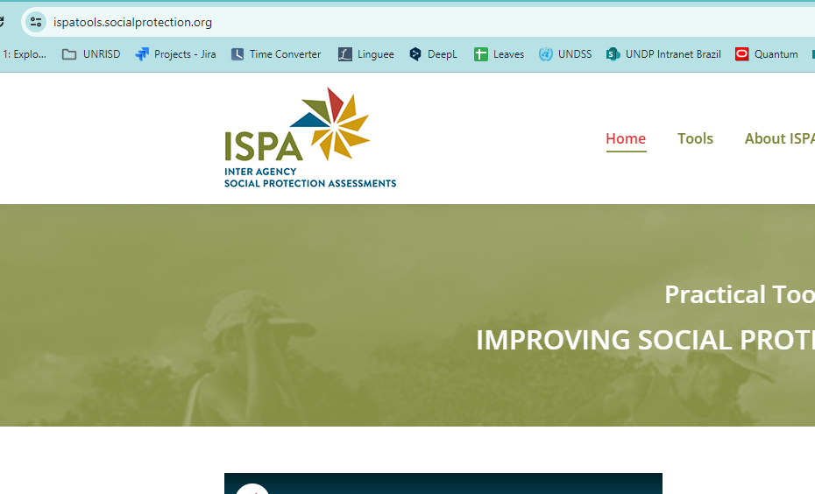
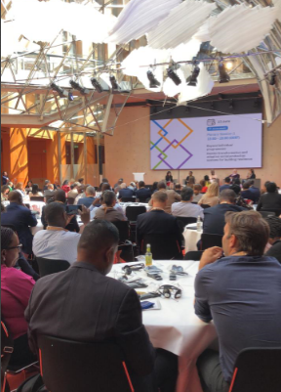
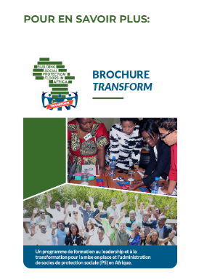
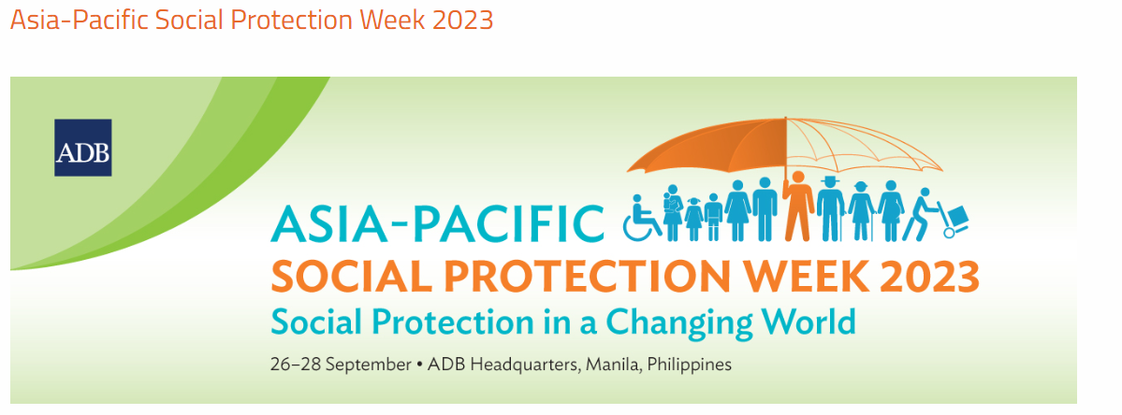
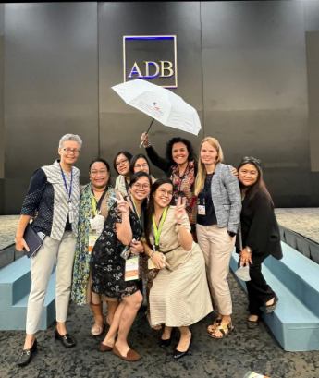
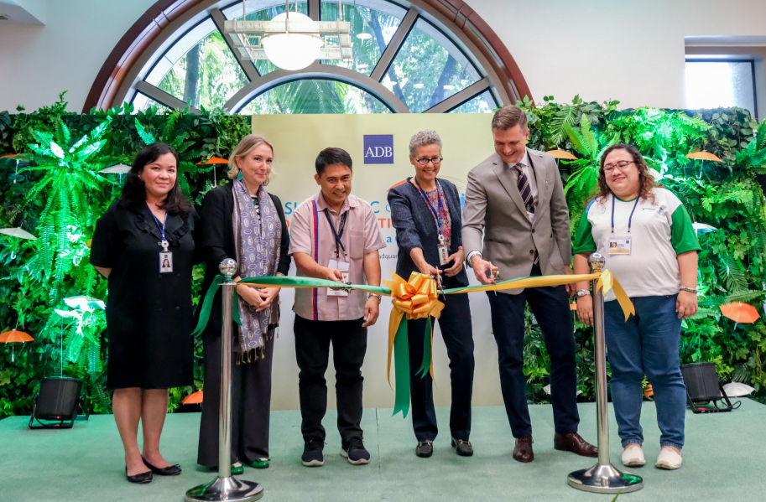
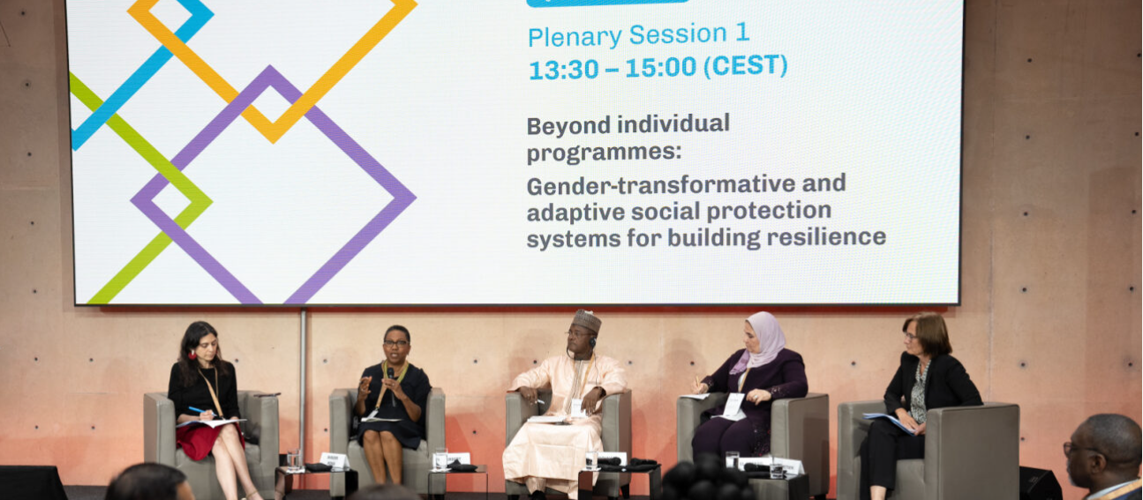
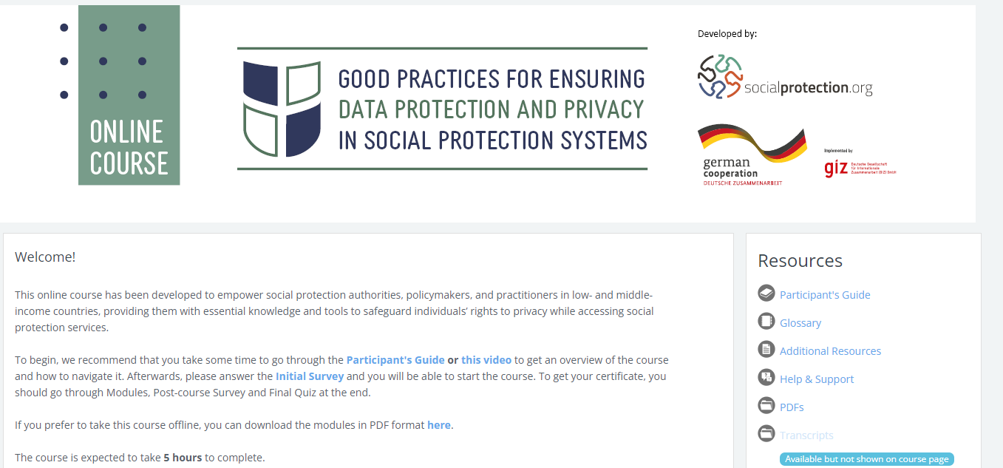
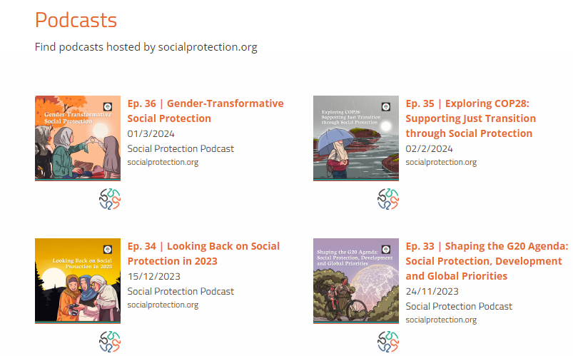
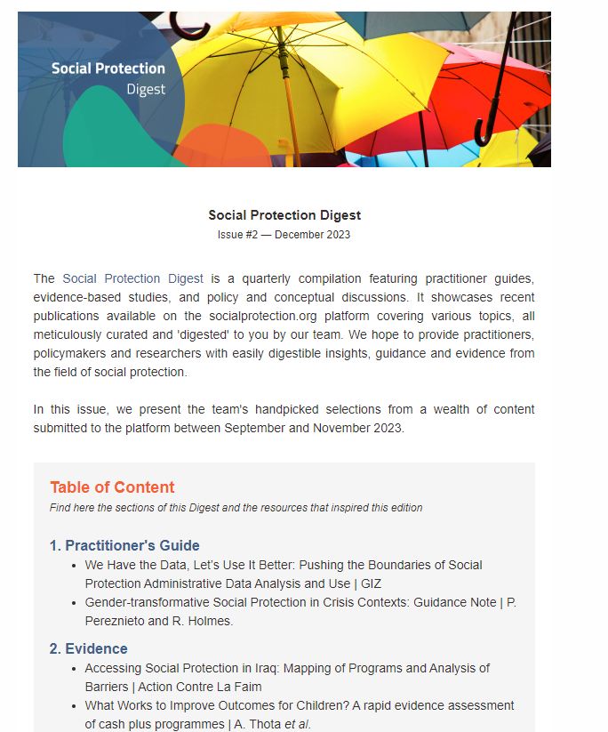
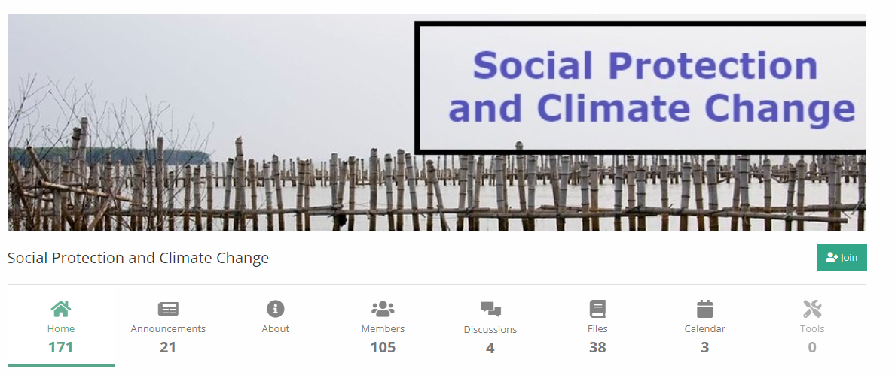
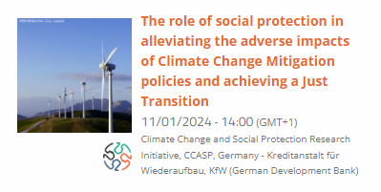
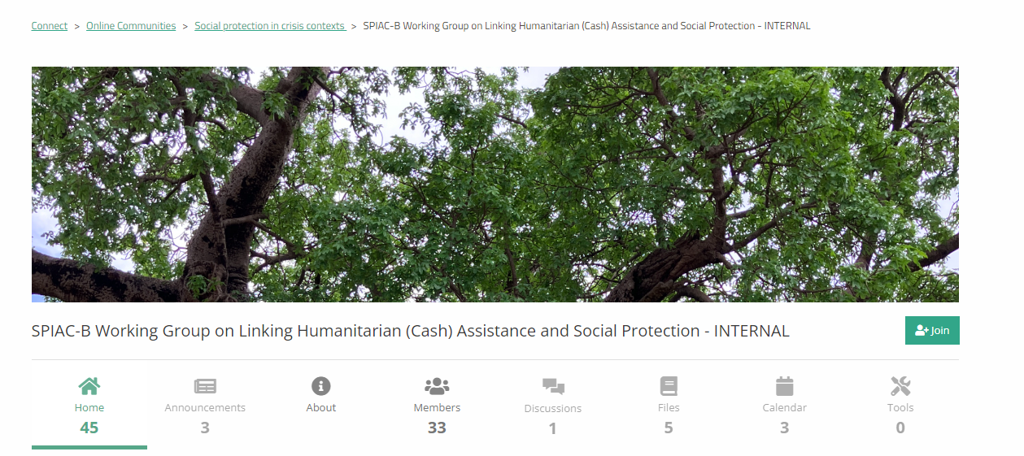
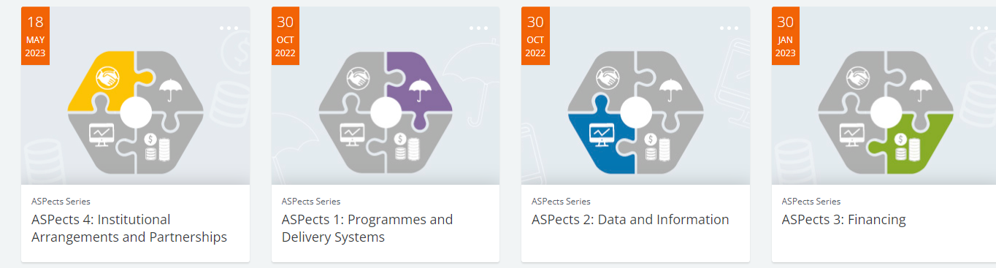
New products to enhance capacity strengthening and knowledge sharing
Fostering exchanges by supporting global events
Support to multistakeholder activities
Support to SPIAC-B / USP2030 WGs

Slide 33
for partners:
socialprotection.org value added
for users:
  Global gateway for exchanging social protection experiences and knowledge, including best practices and challenges.
  Informs users on latest trends and developments in the field, including intersecting and evolving issues, such as climate change, humanitarian crises and GEDSI.
  Offers high-quality learning and training courses on social protection, supporting continuous learning and strengthening capacities.
  Facilitates global and regional networks and partnerships.
  Supports all social protection stakeholders from NGOs, UN agencies, donors, governments, academia and civil society.
  Connects partners with other global stakeholders to enhance learning and best practice.
  Supports informed decision-making and impactful investments in social protection.
  Contributes to innovative policy discussions, resulting in evidence-based policies, strategies, and approaches.
  Supports interagency mechanisms and global initiatives & agendas.
  Enhances partners visibility and credibility in this field due to its extensive outreach.

Slide 34
Funding (USD)
Financial report for the period 2024*-2026
Available budget |  |  | Core resources confirmed | Project resources confirmed | Pending
Donor |  |  | Value in USD | Value in USD | Value in USD
DFAT 2024-26 | core funding | core funding | 1,500,000.00
USAID 2023 |  |  | 300,000.00
GIZ remaining |  |  |  |  | 49,883.92
DFAT remaing |  |  |  |  | 95,000.00
FAO/TRANSFORM | project-based** | project-based** | 3,331.59 | 22,210.62
WFP (PIF + e e-course) |  |  | 18,240.83 | 121,605.50
Unicef e-course |  |  | 11,054.44 | 73,696.25
GIZ AI | in negotiation | in negotiation |  |  | TBC
STAAR/FCDO |  |  |  |  | TBC
 |  |  | 1,832,626.86 | 217,512.37 | 144,883.92
Core cost for the period 2024-2026 (31 months) |  |  | 3,600,000.00
Funding gap |  |  | 1,767,373.14
* 7 months in 2024
** 15% of the total project amount will be charged as 'core funding' fund, ensuring the sustained daily operations of the platform
$1.400.000
Platform’s Maintenance Costs / Year

Slide 35
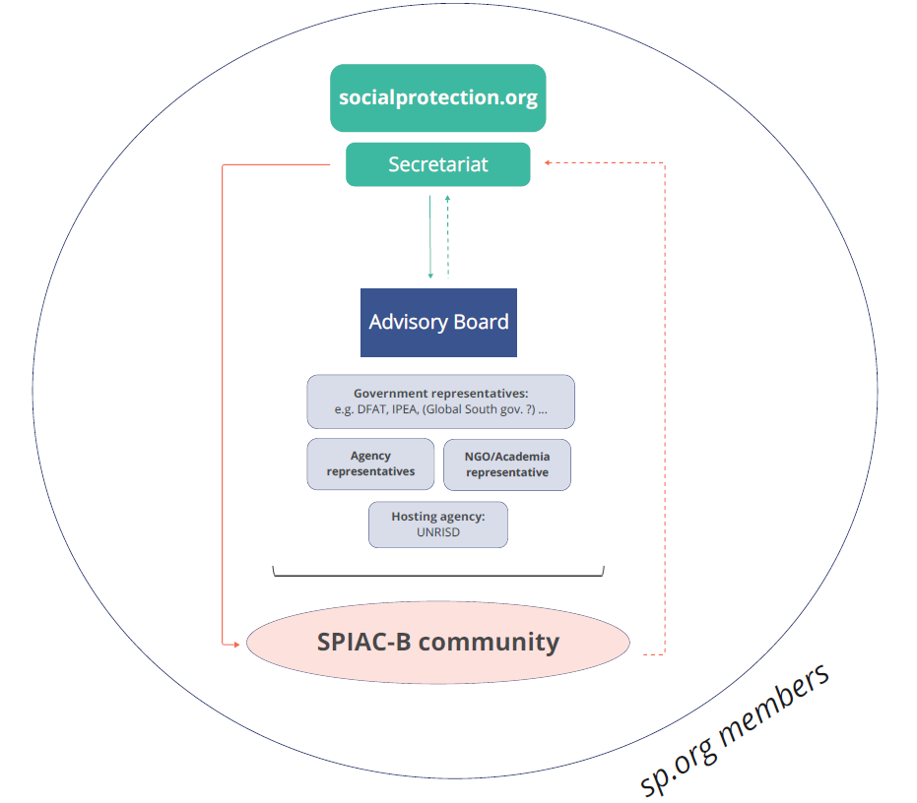
Governance
proposal
Notes:
Objective of this governance framework is to provide sustainability for the platform, in order to improve its functioning, strategy, operations and outreach, but specially to foster and facilitate synergies and collaboration among the social protection community.
As proposed, this light structure would have an advisory board, with rotating voluntary representatives from governments, UN agencies and Development Banks, NGOs and the Academia.
A Secretariat, composed by team members of the socialprotection.org platform who have the responsibility of coordinating the platform's strategy and operations.
the SPIAC-B Community, who would contribute ad hoc with substantial advice and support to advocacy, strategy, and outreach initiatives.
socialprotection.org members, that is expected to actively engage in platform activities
We welcome everyone to participate actively in the governance. We have put together this proposal, which will be circulated, and we expect feedback from the community draft a final version for approval and to able to move forward.

Slide 36
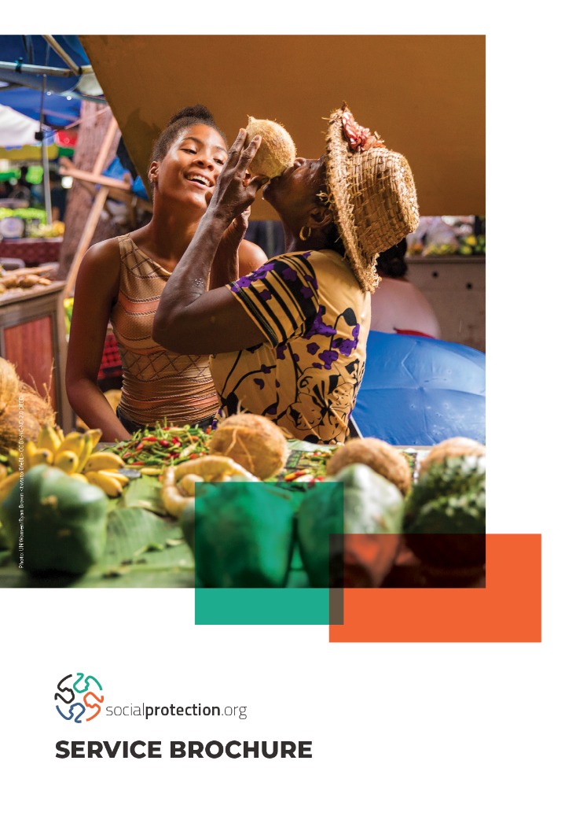
Brochure of services
This catalogue outlines the effective support that the platform can offer to organizations and governments.
Access to all content and basic assistance with knowledge-sharing activities are core services provided by the platform and are offered free of charge.
However, many of the supplementary activities outlined in the document are tailored to specific projects and may involve additional costs.
Notes:
To give you more details of how the platform can support you, we have put together this brochure of services that…

Slide 37
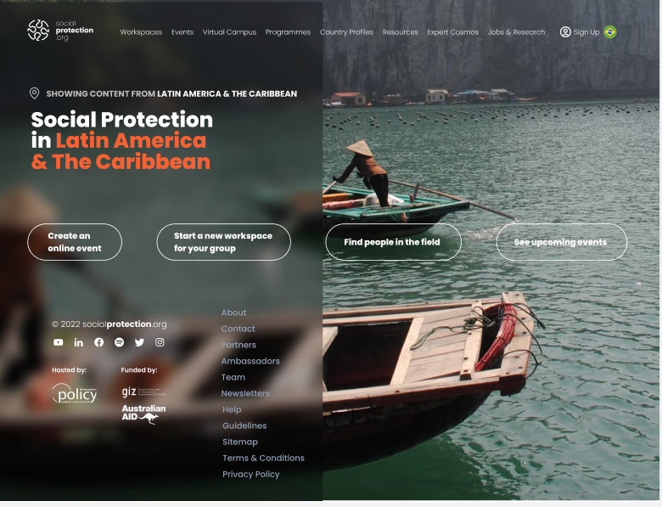
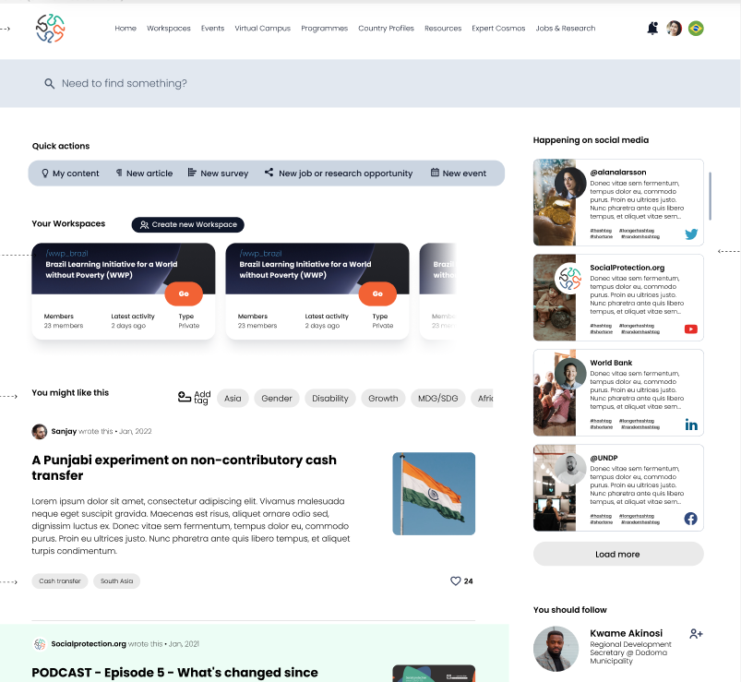
Way forward
Become the one-stop-shop for social protection
  Increase the uptake of the platform by all partners for collaboration including on training activities, sharing evidence and good practices.
  Strengthen support to working groups ( i.e. SPIAC-B, USP20300) and to multistakeholder projects ( i.e. ISPAtools, TRANSFORM)
Foster dialogue, knowledge production and dissemination of emerging global topics related to social protection, such as climate change, just transition, ASP and GEDSI
Amplify engagement with policymakers towards contributing to more effective and inclusive social protection systems globally
  G20 Global Alliance Against Hunger and Poverty
Re-build the platform with a focus on:
  AI-driven platform (with enhanced navigation and search functionality)
    Providing a more personalised service and strengthening the collaborative space for exchanges and networking, using innovative tools

Slide 38
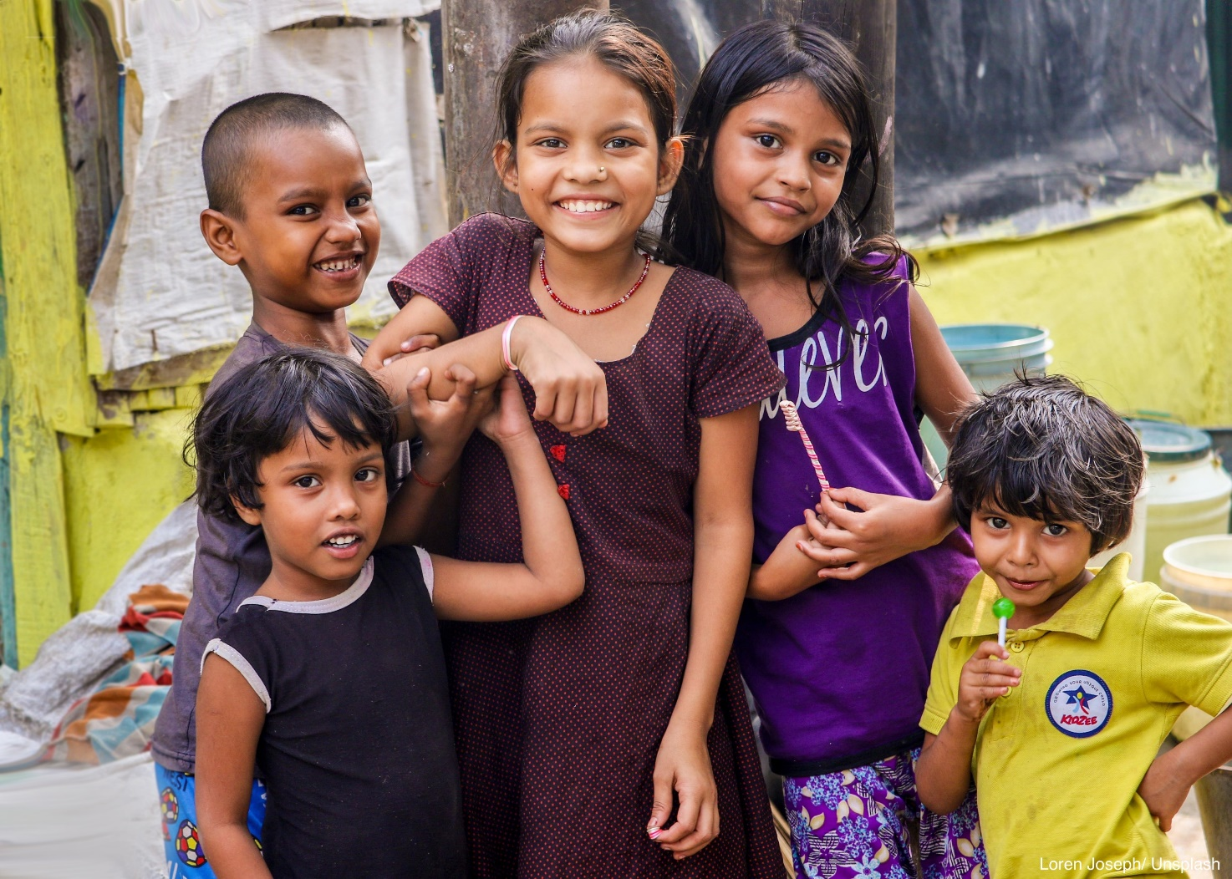





Thank you!
contact@socialprotection.org

Slide 39

A set of practical tools that help countries to develop their social protection systems by analyzing strengths and weaknesses and offering options for improvement
ISPA TOOLS

Slide 40

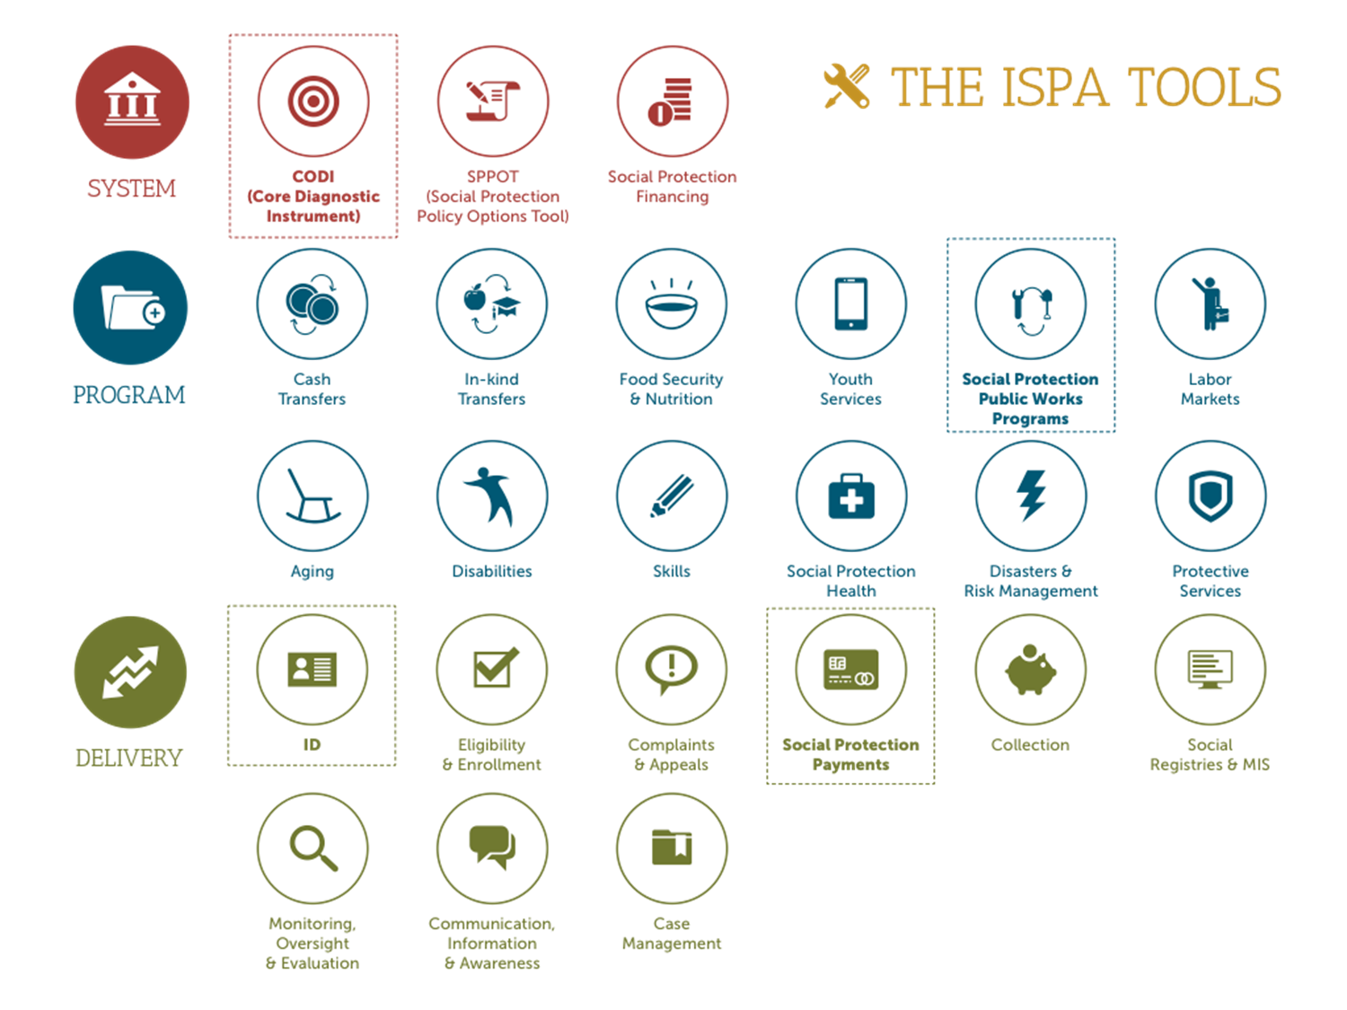
CONSTELLATION OF ENVISIONED ISPA TOOLS

