Slide 1
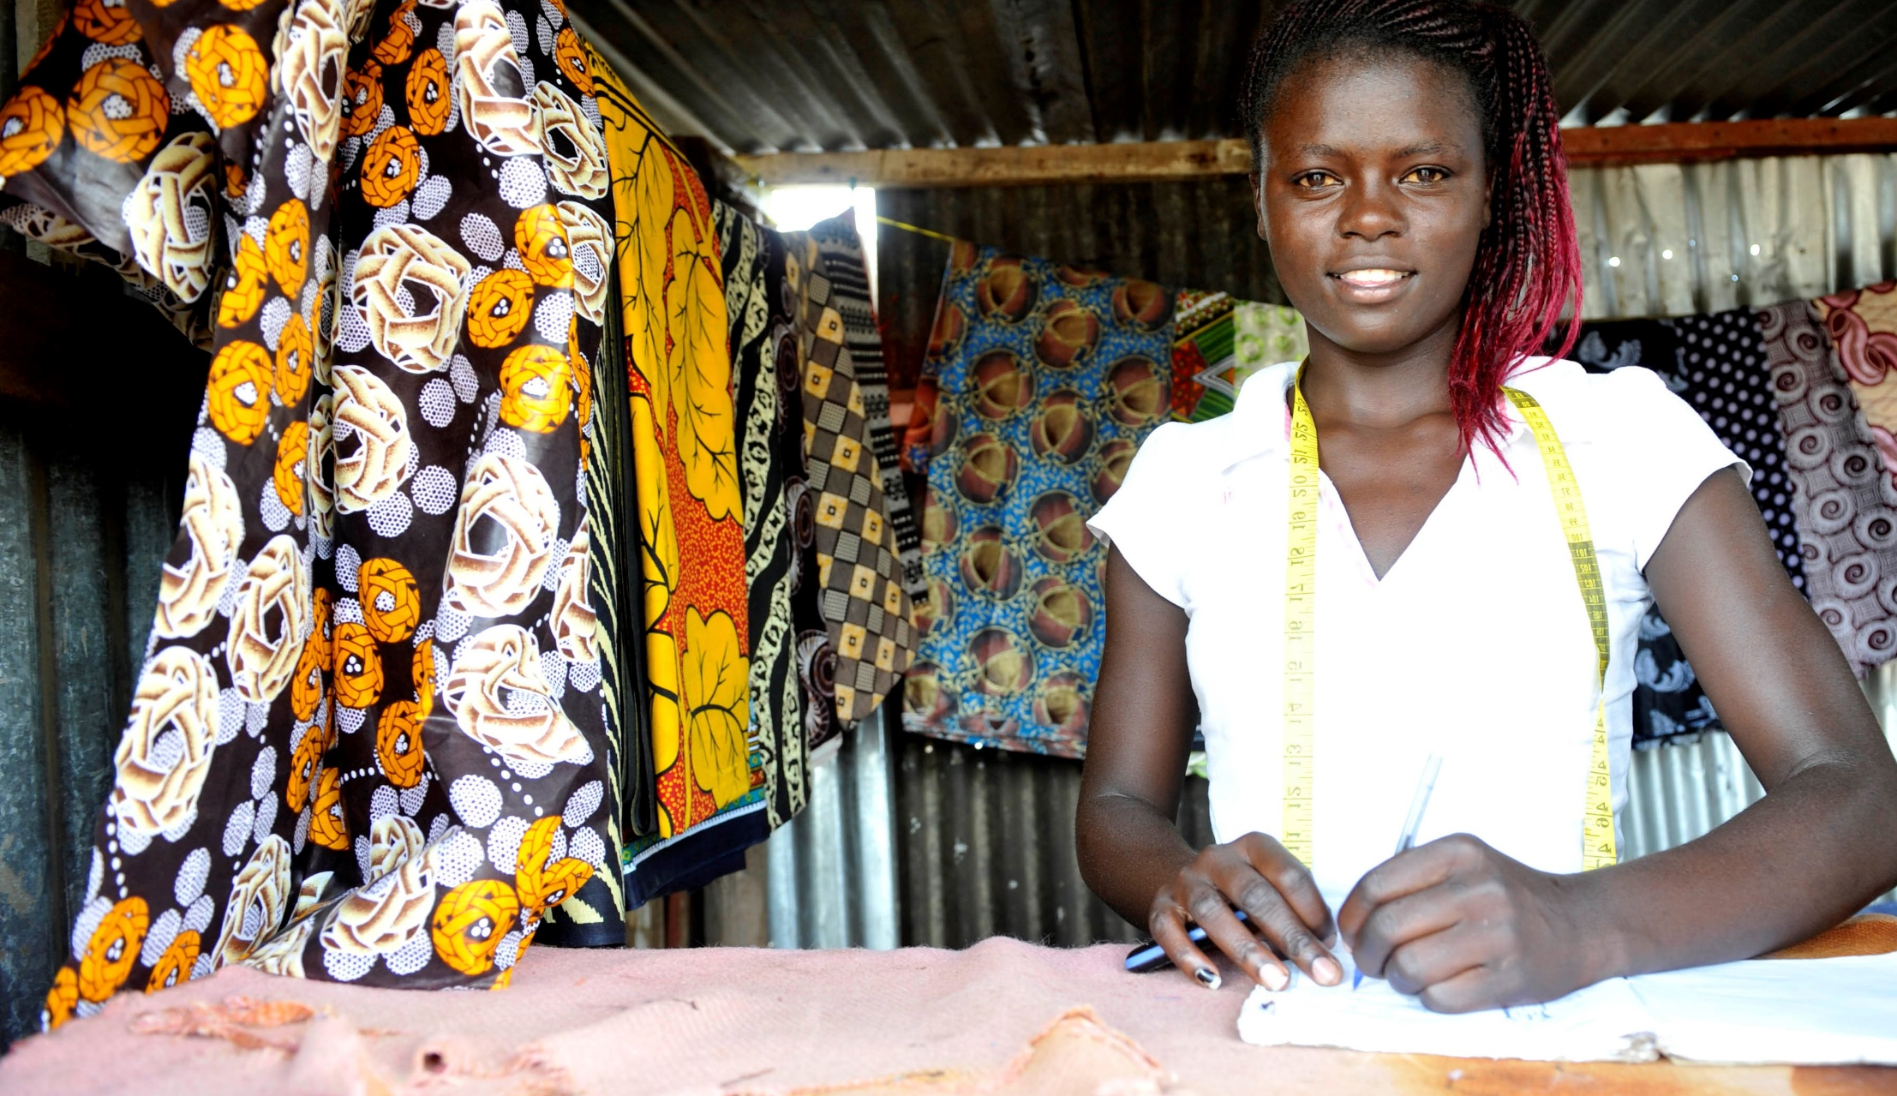
Social Protection Fundamentals
Developing national systems of social protection statistics (NSSPS) in South Africa
Developing national systems of social protection statistics (NSSPS) in South Africa
Developing national system of social protection statistics in South Africa
  Jasmina Papa, Social Protection Specialist, ILO Pretoria DWT for Southern and Eastern Africa

Slide 2

Content
          What do we mean when we say social protection
          Rights based approach to social protection
          Building blocks of a comprehensive system based on International Social Security standards
          Ratification Campaign

Slide 3
Understanding the concept
You say social protection
They say social security
Are we talking about the same or different concepts?
Notes:
Start with a Q: What definition is used in your country?

Slide 4
Understanding the concept
Social protection, or social security, is a human right and is defined as the set of policies and programmes designed to reduce and prevent poverty and vulnerability throughout the life cycle. Social protection includes benefits for children and families, maternity, unemployment, employment injury, sickness, old age, disability, survivors, as well as health protection. Social protection systems address all these policy areas by a mix of contributory schemes (social insurance) and non-contributory tax-financed benefits, including social assistance, social services and in-kind support.
Source: ILO. 2017. "World Social Protection Report 2017-19: Universal social protection to achieve the Sustainable Development Goals". Geneva: International Labour Organization

Slide 5
Rights Based Approach

Slide 6
Rights-Based Approach to Social Protection
Comprehensive National Social Protection Policies and Strategies
Rights-Based Universal Social Protection Systems
Universality
Comprehensiveness
Adequacy
Sustainability
International Human Rights Instruments
ILO
Social Security Standards
Synergetic Core Objectives and Principles
Notes:
A human rights-based approach (HRBA) is a conceptual framework that is normatively based on international human rights standards and operationally directed to promoting and protecting human rights. It seeks to analyse obligations, inequalities and vulnerabilities, and to tackle discriminatory practices and unjust distributions of power that impede and undercut human rights.
Under a human rights-based approach, plans, policies and programmes are anchored in a system of rights and corresponding obligations established by international law. This helps to promote sustainability, empowering people themselves (rights holders)—especially the most marginalized—to participate in policy formulation and hold accountable those who have a duty to act (duty bearers). UN agencies have agreed (see below) that a human rights-based approach consists of a number of essential attributes:
As policies and programmes are formulated, the main objective should be to fulfil human rights.
A human rights-based approach identifies rights holders and their entitlements and corresponding duty bearers and their obligations, and works towards strengthening the capacities of rights holders to make their claims and of duty bearers to meet their obligations.
Principles and standards derived from international human rights treaties should guide all policies and programming in all sectors and in all phases of the process.
In practical terms, a human rights-based approach can be used to guide policies and measures of poverty. It can inform assessments and strengthen processes; it can be a mechanism for ensuring access to essential information, effective participation, and the provision of access to justice.

Slide 7
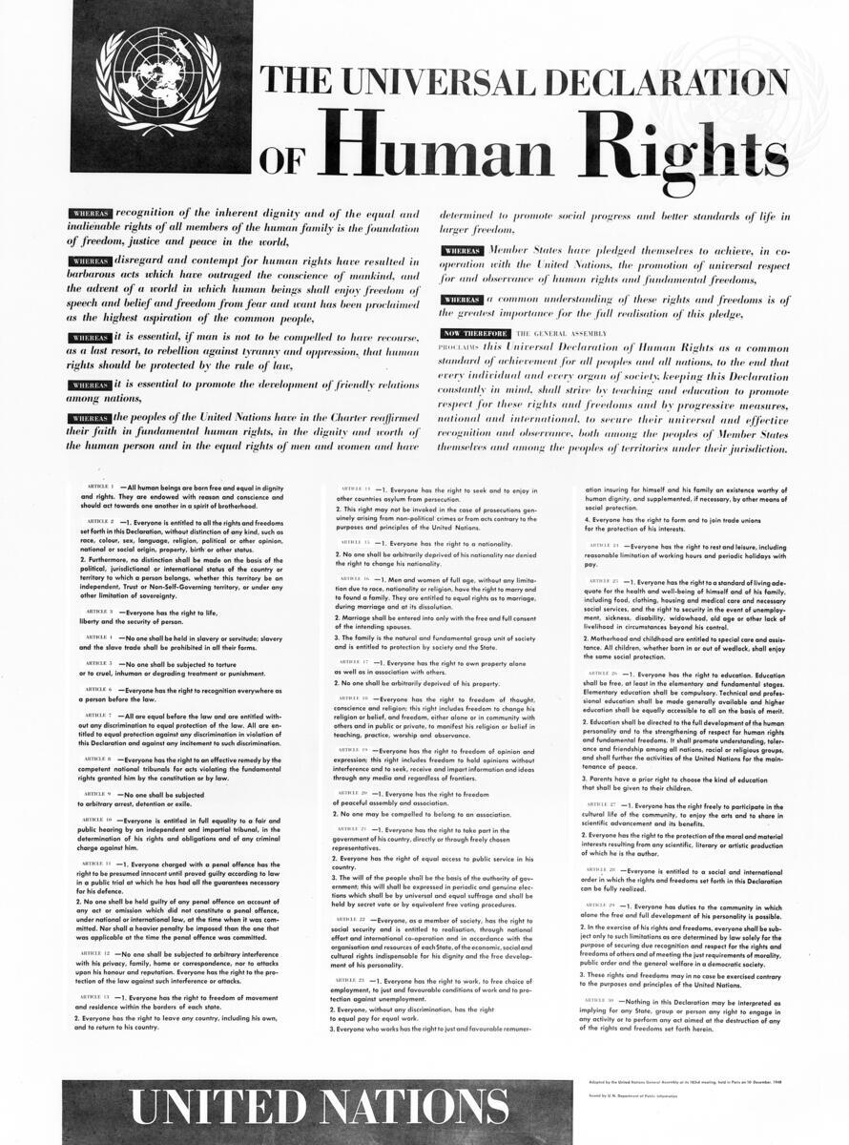
The Universal Declaration of Human Rights (1948)
7
Article 25
(1) Everyone has the right to a standard of living adequate for the health and well-being of himself and of his family, including (…) medical care and necessary social services, and the right to security in the event of unemployment, sickness, disability, widowhood, old age or other lack of livelihood in circumstances beyond his control. (…)
(2) Motherhood and childhood are entitled to special care and assistance. All children, (…) shall enjoy the same social protection.
Article 22
Everyone, as a member of society, has the right to social security (…)
Notes:
“as a member of society” – not categorising segments of the population – the reference is to everyone, irrespective of whether you live urban/rural, young/old; sick/healthy; rich/poor; tall/or tiny; resident/non-resident; male/female-- everyone

Slide 8

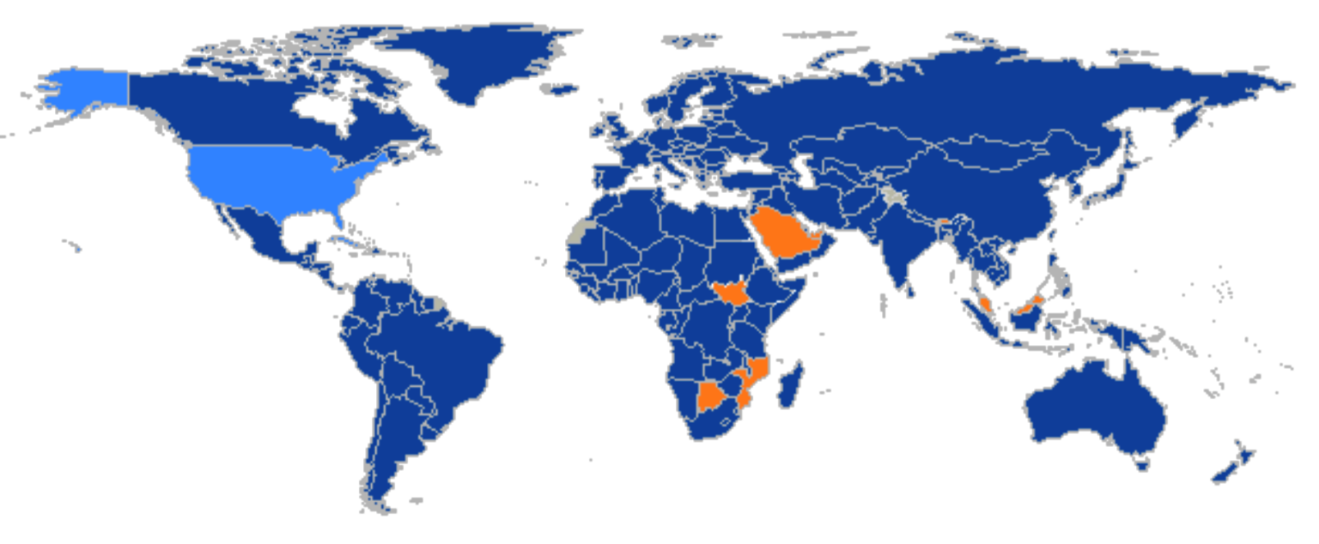
International Covenant on Economic, Social and Cultural Rights (1966)
Article 12
1. The State Parties to the present Covenant recognise the right of everyone to the enjoyment of the highest attainable standards of physical and mental health. (…)
Article 9
The State Parties to the present Covenant recognise the right of everyone to social security, including social insurance.
172 State Parties
to the Covenant have committed themselves to guarantee the right of everyone to social security.
Notes:
The human right to health and social security have been enshrined by the international human rights framework and notably the Universal Declaration of Human Rights of 1948 and the International Covenant on Economic Social and Cultural Rights of 1966. Ultimately, everyone, as a member of society, and therefore irrespective of their race, age, religion, sex or anything else, has the right to social security and to health. In addition, the State parties to the International Covenant, which is today the vast majority of nation-States, have an obligation to respect, protect and fulfil these rights in law and in practice.
The human right to social security implies the relationship to other human rights. This is because the right to access and maintain benefits to secure protection from lack of work related income (caused by sickness, disability, maternity, employment injury, unemployment, old age or death), lack of access to health care and insufficient family support is intrinsically linked to the right to an adequate standard of living, the right to food and water and sanitation, the right to education, and of course the right to the highest attainable standard of health. Therefore, social protection systems can help States in complying with their obligations regarding the right to health, in as much as health systems can contribute to the realisation of the human right to social security.
SA ratified ICESCR on 12 January 2015

Slide 9
Other Global Human Rights Instruments
1951
Convention relating to the Status of Refugees
1965
Convention on the Elimination of All Forms of Racial Discrimination
1990
International Covenant on the Protection of the Rights of All Migrant Workers and their Families
2006
Convention on the Rights of Persons with Disabilities
1950
1960
1970
1980
1990
2000
2010
1954
Convention relating to the Status of Stateless Persons
1979
Convention on the Elimination of All Forms of Discrimination Against Women
1989
Convention on the Rights of the Child
2007
Declaration on the Rights of Indigenous People
Notes:
Apart from these general instruments, the right to social security of women, children, migrant workers and their families, indigenous and tribal persons, persons with disabilities, and refugees has been reaffirmed by thematic international treaties, such as:

Slide 10

Regional Human Rights Instruments
Europe and Central Asia
The European Social Charter (1961)
Commonwealth of Independent States Convention on Human Rights and Fundamental Freedoms (1995)
Charter of Fundamental Rights of the European Union (2000)
Latin America and the Caribbean
American Declaration on the Rights and Duties of Persons (1948)
Additional Protocol to the American Convention on Human Rights in the Area of Economic, Social and Cultural Rights (1988)
Inter-American Convention on the Protection of the Human Rights of Older Persons (2015)
Africa
The African Charter on Human and Peoples’ Rights (1981)
Protocol to the African Charter on Human and Peoples' Rights on the Rights of Citizens to Social Protection and Social Security (2022)
ILO –AU Africa Regional Social Protection Strategy
East African Community in the process of finalisation of EAC Social Protection Policy
Asia and the Pacific
ASEAN Human Rights Declaration (2013)
Arab States
The Arab Charter on Human Rights (2004)
Notes:
Protocol to the African Charter on Human and People’s Rights on the Rights of Citizens to Social Protection and Social Security
African Charter on Human and People’s Rights (1981)
The Charter has no express provision recognizing the right to social security.
Certain aspects of the right may, however, be derived from Article 16, the right to health, and Article 18(4), the right of the aged and disabled to special measures of protection.
Additional Protocol to the American Convention on Human Rights in the Area of Economic, Social and Cultural Rights, 1988
Everyone shall have the right to social security protecting him from the consequences of old age and of disability which prevents him, physically or mentally, from securing the means for a dignified and decent existence. In the event of the death of a beneficiary, social security benefits shall be applied to his dependants.
Everyone shall have the right to health, understood to mean the enjoyment of the highest level of physical, mental and social well-being.
Primary health care, universal immunization, prevention and treatment endemic, occupational and other diseases..

Slide 11
Building comprehensive social protection systems based on international social security standards

Slide 12
Comprehensive social protection systems
STRENGHTENING
TAX-FINANCED,
NON-CONTRIBUTORY MECHANISMS
to guarantee a basic level of protection for everyone, including those not covered by other schemes
STRENGTHENING AND ADAPTING
SOCIAL INSURANCE MECHANISMS
to ensure higher levels of protection based on principles of solidarity, sustainability and equity
high
  Vertical dimension: progressively ensuring
  higher levels of protection, guided by Convention No.102 and
  more advanced standards
voluntary
insurance/savings
under gov. regulation
Universal access to adequate, comprehensive and sustainable social protection
(SDGs 1.3, as well as SDGs 3.8, 5.4, 8.5, 10.4 and 16.6)
Facilitating labour market transitions and labour mobility, and empowering individuals
to seize new opportunities, especially if linked to other measures to promote decent work.
Facilitating transitions from the informal to the formal economy
level of protection
social protection benefits
of guaranteed levels
(usually social insurance)
social protection floor: basic income security
and access to health care for all
Social insurance
low
Two-track approach of extending social protection in line with
ILO Social Protection Floors Recommendation, 2012 (No. 202) and
ILO Transition from the Informal to the Formal Economy Recommendation, 2015
(No. 204)
Reinforcing social protection systems in line with ILO Social Security (Minimum Standards) Convention, 1952 (No. 102) and other ILO social security standards
low
individual/household income
high
  Horizontal dimension:
  Guaranteeing access to essential health care
  and minimum income security for all,
  guided by Recommendation No. 202

Slide 13
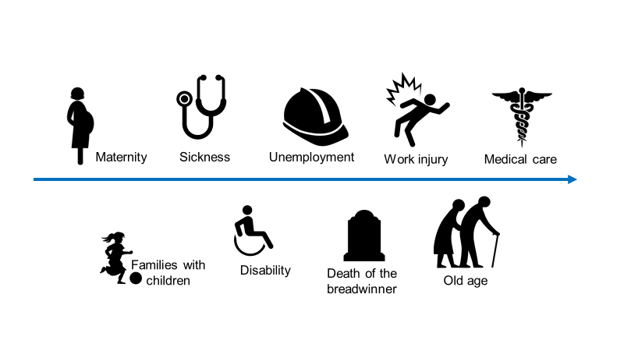
Elements of a comprehensive systems
Social Protection Floors Recommendation, 2012 (No. 202). Four basic social security guarantees:
All residents have effective access to at least essential health services
All children have at least basic income security
All older persons have at least basic income security
All persons of working age have at least basic income security, including in case of maternity, sickness, disability, employment injury and unemployment
Social Security (Minimum Standards)
Convention 102 (1952). Nine branches:
Notes:
Human rights mechanisms stipulate State’s obligation to respect, protect and fulfil the right to social protection, ILO conventions stipulate specific obligations of the state

Slide 14
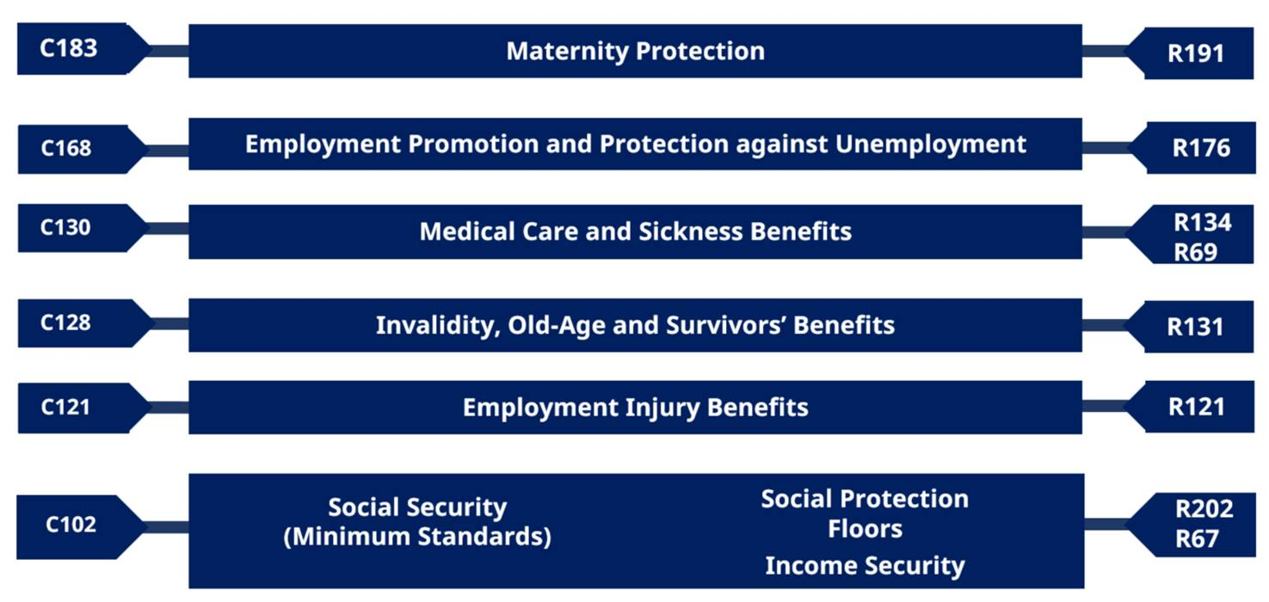
Up-to-date ILO Social Security Standards
Principles:
  Universality,
  Adequacy
  Acessibility
  Equality of treatment, non-discrimination and inclusiveness
  Comprehensiveness and coherence
  Sustainability
  Solidarity
  Governance (tripartite)
For more details: Building social protection systems: International standards and human rights instruments:
https://www.ilo.org/wcmsp5/groups/public/---ed_protect/---soc_sec/documents/publication/wcms_651219.pdf

Slide 15



International Social Security Standards
Qualitative and quantitative benchmarks which together determine the minimum standards of social protection
Definition of contingency
Persons protected
Type and level of benefits
Entitlement conditions, including qualifying period
Duration of benefit and waiting period
Which risks must be covered?
Who must be covered?
What should be provided?
What qualifies a person?
How long must benefits be paid?

Slide 16
International Social Security Standards: reference for building universal social protection systems
    Standards serve as key references for governments, employers, and workers for inter alia:
    the development and maintenance of comprehensive national social security systems;
    drafting social security law.
    the design and parametric adjustments of social security schemes;
    the establishment and implementation of effective recourse, enforcement and compliance mechanisms;
    the elaboration of national social protection extension strategies;
    Working towards the achievement of the SDGs, particularly goals 1, 3, 5, 8, 10 and 16.
    General Surveys on particular subject area in member States that have or have not ratified convention
    General Survey on Social Protection Floors R 202, 2019
    reports by 114 governments and observations submitted by 11 employers’ and 44 workers’ organizations
    General Survey 2025 on Employment Injury (submissions of reports until February 2024)
    Quantitative data collection instruments
Notes:
Common rules and principles
ILO social security standards set out common rules of collective organisation, financing and management of social security, as well as principles for the good governance of national systems.
Examination of law and practice in a particular subject area, in member States that have or have not ratified relevant conventions.
International labour standards are universal instruments adopted by the international community and reflecting common values and principles on work-related issues. While member States can choose whether or not to ratify Conventions, the ILO considers it important to keep track of developments in all countries, whether or not they have ratified them.
Under article 19 of the ILO Constitution, member States are required to report at regular intervals, at the request of the Governing Body, on measures they have taken to give effect to the provisions of certain Conventions or Recommendations, and to indicate any obstacles which have prevented or delayed the ratification of a particular Convention.
ILO standards provide concrete guidance for countries to realise the right to social security and the effective implementation of a rights-based approach to social security.
ILO social security standards are unique:
They establish standards that States set for themselves.
They build on good practices and innovative mechanisms.
ILO social security standards are flexible:
They are build on the notion that there is no single perfect model for social security.
It is for each society to develop the best means.
They offer a range of options and flexible routes for their application.
Govt of South Africa provided inputs to General Survey on R 202

Slide 17
Useful resources
ILO Social Protection Platform
Joint UN Social Protection and Human Rights web platform
Global Partnership for Universal Social Protection (USP2030)
World Social Protection Report 2024-26: Universal Social Protection for Climate Action and Just Transitions
Up to date ILO Social Security Conventions and Recommendations
Building social protection systems: International standards and human rights instruments. A reference for practitioners, policymakers and other stakeholders, as well as a guidebook for the general public
General Survey concerning the Social Protection Floors Recommendation, 2012 (No. 202)

Slide 18

18
Questions?
Thank you!

